Slide 1



WILEY
IFRS EDITION
Prepared by
Coby Harmon
University of California, Santa Barbara
Westmont College

Slide 2
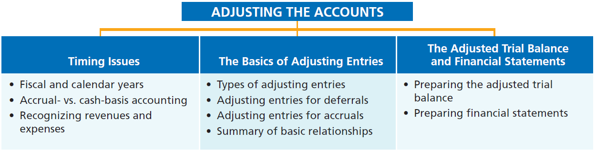
PREVIEW OF CHAPTER 3
Financial Accounting
IFRS 3rd Edition
Weygandt ● Kimmel ● Kieso

Slide 3
CHAPTER
3
Adjusting the Accounts
LEARNING OBJECTIVES
After studying this chapter, you should be able to:
Explain the time period assumption.
Explain the accrual basis of accounting.
Explain the reasons for adjusting entries.
Identify the major types of adjusting entries.
Prepare adjusting entries for deferrals.
Prepare adjusting entries for accruals.
Describe the nature and purpose of an adjusted trial balance.

Slide 4
Timing Issues
Learning Objective 1 Explain the time period assumption.
Accountants divide the economic life of a business into artificial time periods (Time Period Assumption).
. . . . .
Jan.
Feb.
Mar.
Apr.
Dec.
Generally a month, a quarter, or a year.
Also known as the “Periodicity Assumption”
LO 1

Slide 5
Fiscal and Calendar Years
Monthly and quarterly time periods are called interim periods.
Most large companies must prepare both quarterly and annual financial statements.
Fiscal Year = Accounting time period that is one year in length.
Calendar Year = January 1 to December 31.
LO 1

Slide 6
Fiscal and Calendar Years
Question
The time period assumption states that:
companies must wait until the calendar year is completed to prepare financial statements.
companies use the fiscal year to report financial information.
the economic life of a business can be divided into artificial time periods.
companies record information in the time period in which the events occur.
LO 1

Slide 7
Accrual- versus Cash-Basis Accounting
Learning Objective 2 Explain the accrual basis of accounting.
Accrual-Basis Accounting
Transactions recorded in the periods in
which the events occur.
Companies recognize revenues when they perform services (rather than when they receive cash).
Expenses are recognized when incurred (rather than when paid).
LO 2

Slide 8
Accrual- versus Cash-Basis Accounting
Cash-Basis Accounting
Revenues are recorded when cash is received.
Expenses are recorded when cash is paid.
Cash-basis accounting is not in accordance with International Financial Reporting Standards (IFRS).
LO 2

Slide 9
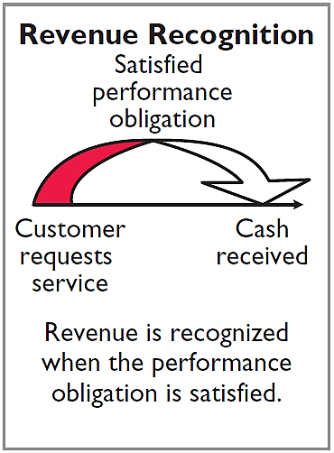
Recognizing Revenues and Expenses
REVENUE RECOGNITION PRINCIPLE
Recognize revenue in the accounting period in which the performance obligation is satisfied.
LO 2

Slide 10
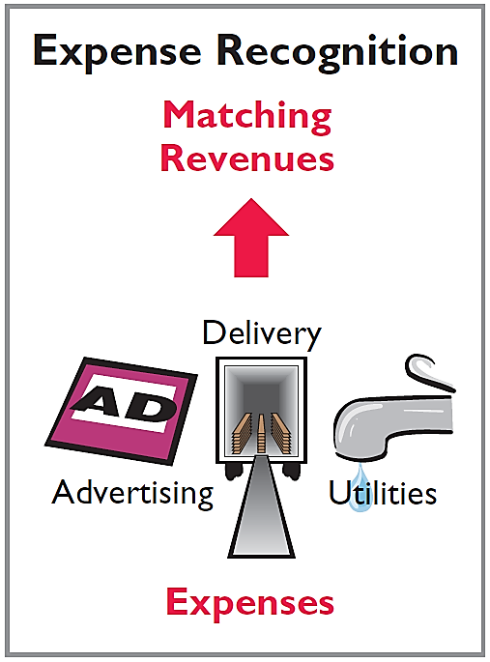
Recognizing Revenues and Expenses
EXPENSE RECOGNITION PRINCIPLE
Match expenses with revenues in the period when the company makes efforts to generate those revenues.
“Let the expenses follow the revenues.”
LO 2

Slide 11
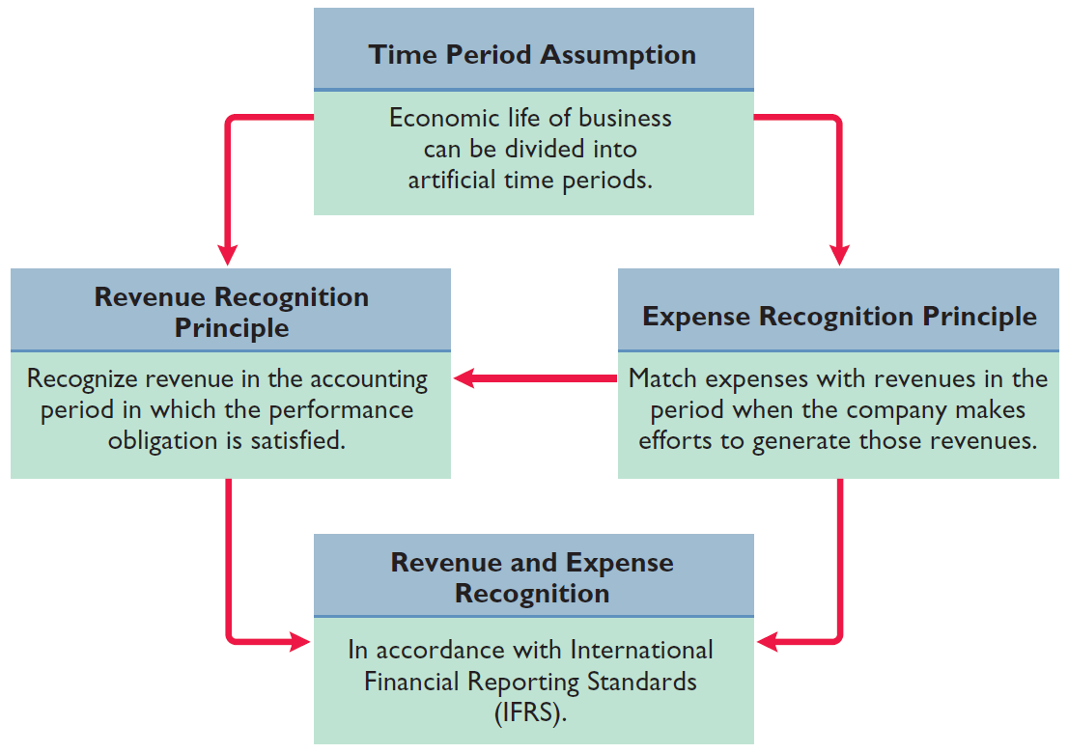
Illustration 3-1
IFRS relationships in revenue and expense recognition
LO 2

Slide 12
Recognizing Revenues and Expenses
Question
The revenue recognition principle states that:
revenue should be recognized in the accounting period in which a performance obligation is satisfied.
expenses should be matched with revenues.
the economic life of a business can be divided into artificial time periods.
the fiscal year should correspond with the calendar year.
LO 2

Slide 13
ETHICS INSIGHT
Why Accuracy Matters
Krispy Kreme (USA)
Cooking the Books?
Allegations of abuse of the revenue recognition principle have become all too common in recent years. For example, it was alleged that Krispy Kreme (USA) sometimes doubled the number of doughnuts shipped to wholesale customers at the end of a quarter to boost quarterly results. The customers shipped the unsold doughnuts back after the beginning of the next quarter for a refund. Conversely, Computer Associates International (USA) was accused of backdating sales—that is, reporting a sale in one period that did not actually occur until the next period in order to achieve the earlier period’s sales targets.
LO 2

Slide 14
>
DO IT!
A list of concepts is provided in the left column below, with a description of the concept in the right column below. There are more descriptions provided than concepts. Match the description of the concept to the concept.
1. ___ Accrual-basis accounting.
2. ___ Calendar year.
3. ___ Time period assumption.
4. ___ Expense recognition principle.
f
Monthly and quarterly time periods.
Efforts (expenses) should be matched with results (revenues).
Accountants divide the economic life of a business into artificial time periods.
Companies record revenues when they receive cash and record expenses when they pay out cash.
An accounting time period that starts on January 1 and ends on December 31.
Companies record transactions in the period in which the events occur.
e
c
b
LO 2

Slide 15
The Basics of Adjusting Entries
Learning Objective 3 Explain the reasons for adjusting entries.
Adjusting Entries
Ensure that the revenue recognition and
expense recognition principles are followed.
Necessary because the trial balance may not contain up-to-date and complete data.
Required every time a company prepares financial statements.
Will include one income statement account and one statement of financial position account.
LO 3

Slide 16
Adjusting Entries
Question
Adjusting entries are made to ensure that:
expenses are recognized in the period in which they are incurred.
revenues are recorded in the period in which services are performed.
statement of financial position and income statement accounts have correct balances at the end of an accounting period.
All the responses above are correct.
LO 3

Slide 17
Types of Adjusting Entries
Learning Objective 4 Identify the major types of adjusting entries.
Deferrals
Accruals
1. Prepaid Expenses. Expenses paid in cash before they are used or consumed.
1. Accrued Revenues. Revenues for services performed but not yet received in cash or recorded.
2. Unearned Revenues.
Cash received before services are performed.
2. Accrued Expenses. Expenses incurred but not yet paid in cash or recorded.
Illustration 3-2
Categories of adjusting entries
LO 4

Slide 18
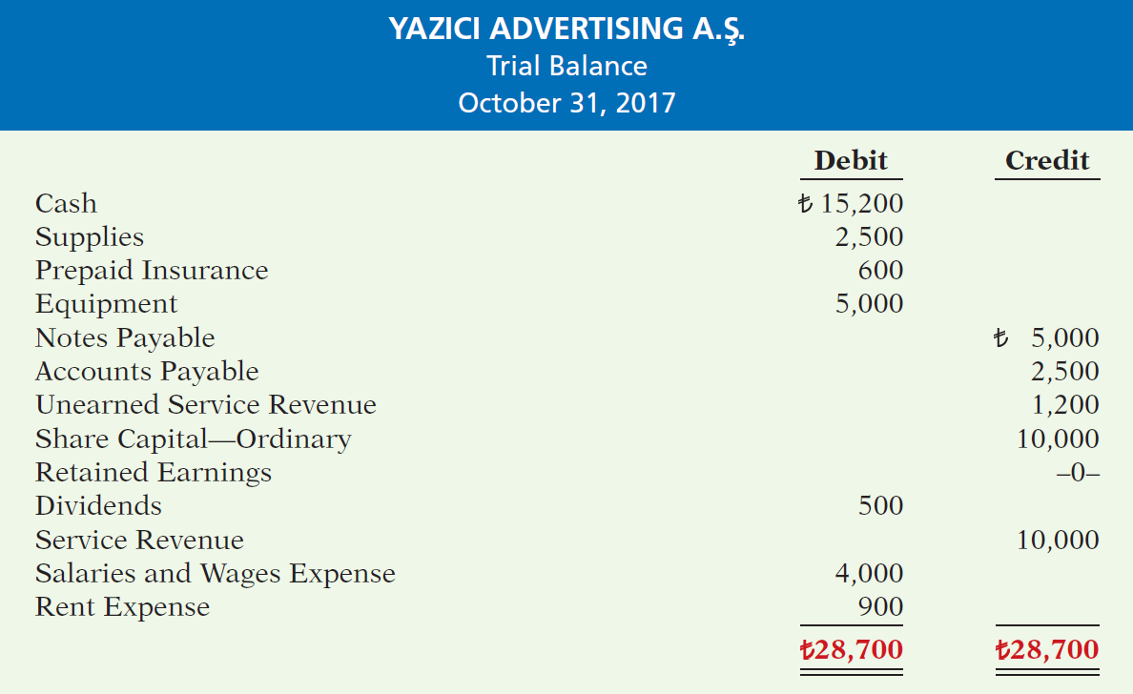
Illustration 3-3
Trial balance
Each account is analyzed to determine whether it is complete and up-to-date for financial statement purposes.
LO 4

Slide 19
Adjusting Entries for Deferrals
Learning Objective 5 Prepare adjusting entries for deferrals.
Deferrals are expenses or revenues that are recognized at a date later than the point when cash was originally exchanged. There are two types:
Prepaid expenses and
Unearned revenues.
LO 5

Slide 20
PREPAID EXPENSES
Payments of expenses that will benefit more than one accounting period.
Cash Payment
BEFORE
Expense Recorded
Prepayments often occur in regard to:
insurance
supplies
advertising
rent
buildings and equipment
LO 5

Slide 21
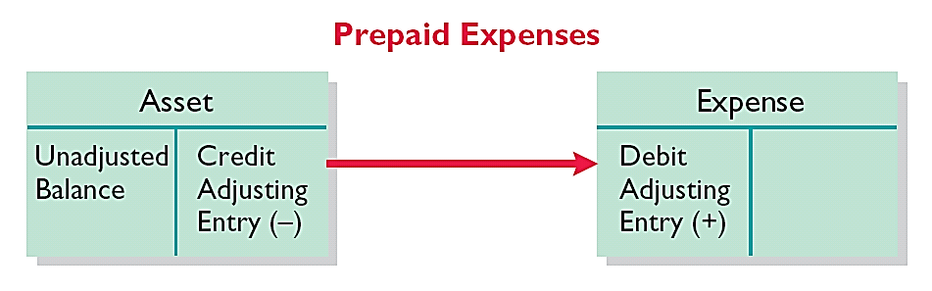
PREPAID EXPENSES
Expire either with the passage of time or through use.
Adjusting entry:
Increase (debit) to an expense account and
Decrease (credit) to an asset account.
Illustration 3-4
Adjusting entries for prepaid
expenses
LO 5

Slide 22
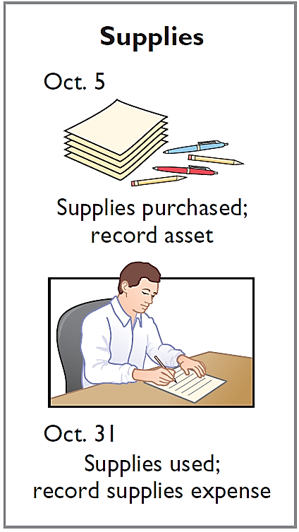
PREPAID EXPENSES
Illustration: Yazici Advertising Inc. Inc. purchased supplies costing ₺2,500 on October 5. Yazici recorded the purchase by increasing (debiting) the asset Supplies. This account shows a balance of ₺2,500 in the October 31 trial balance. An inventory count at the close of business on October 31 reveals that ₺1,000 of supplies are still on hand.
Oct. 31
Supplies Expense
1,500
Supplies
1,500
LO 5

Slide 23
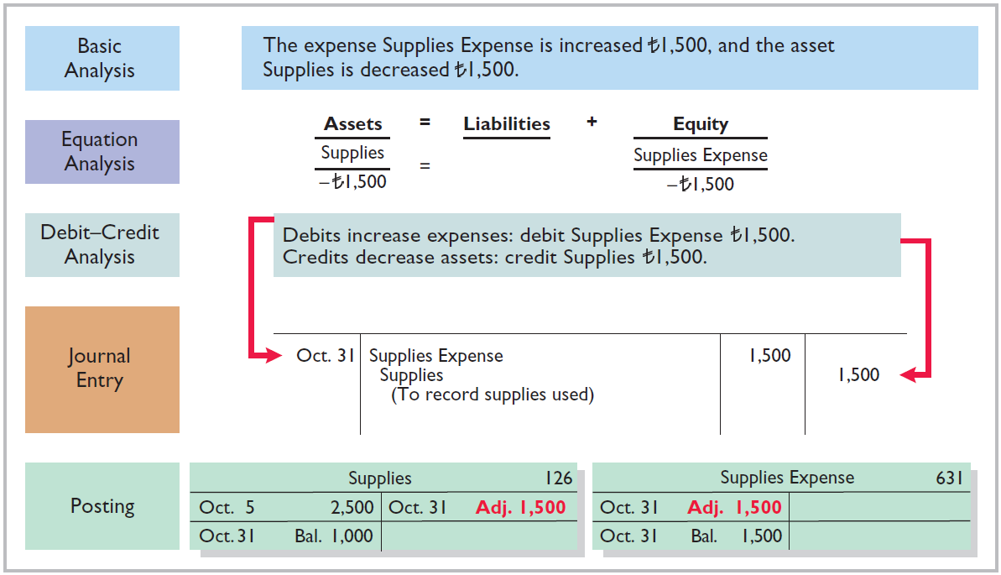
Illustration 3-5
Adjustment for supplies
LO 5

Slide 24
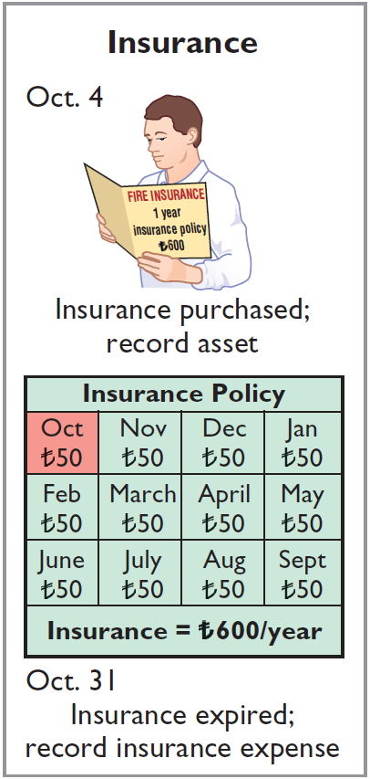
PREPAID EXPENSES
Illustration: On October 4, Yazici Advertising Inc. paid ₺600 for a one-year fire insurance policy. Coverage began on October 1. Yazici recorded the payment by increasing (debiting) Prepaid Insurance. This account shows a balance of ₺600 in the October 31 trial balance. Insurance of ₺50 (₺600 ÷ 12) expires each month.
Oct. 31
Insurance Expense
50
Prepaid Insurance
50
LO 5

Slide 25
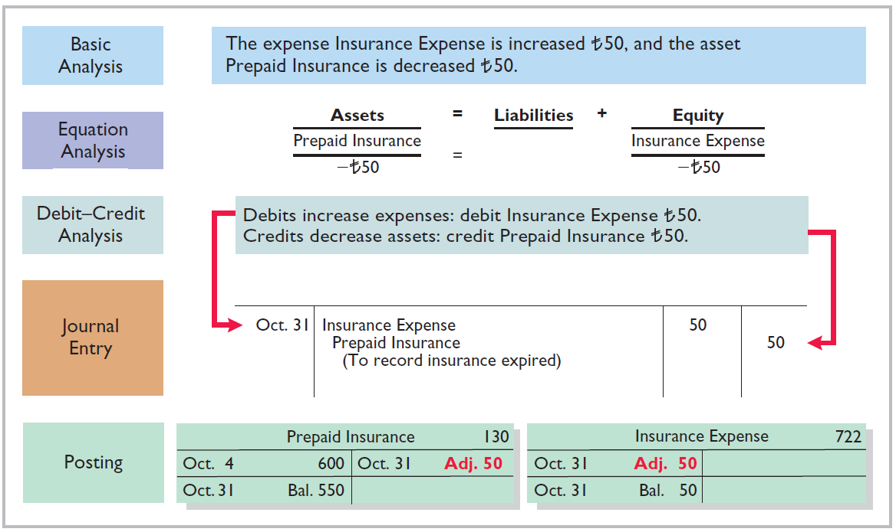
Illustration 3-6
Adjustment for insurance
LO 5

Slide 26
PREPAID EXPENSES
DEPRECIATION
Buildings, equipment, and motor vehicles (assets that provide service for many years) are recorded as assets, rather than an expense, on the date acquired.
Depreciation is the process of allocating the cost of an asset to expense over its useful life.
Depreciation does not attempt to report the actual change in the value of the asset.
LO 5

Slide 27
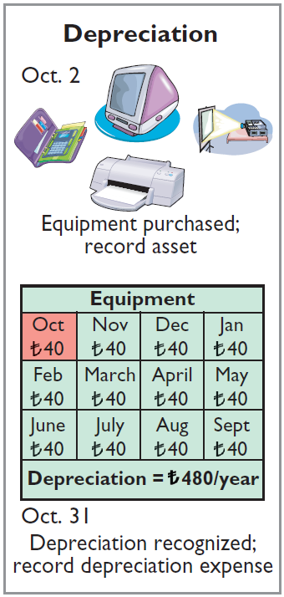
PREPAID EXPENSES
Illustration: For Yazici Advertising, assume that depreciation on the equipment is ₺480 a year, or ₺40 per month.
Oct. 31
Depreciation Expense
40
Accumulated Depreciation
40
Accumulated Depreciation is called a contra asset account.
HELPFUL HINT
All contra accounts have increases, decreases, and normal balances opposite to the account to which they relate.
LO 5

Slide 28
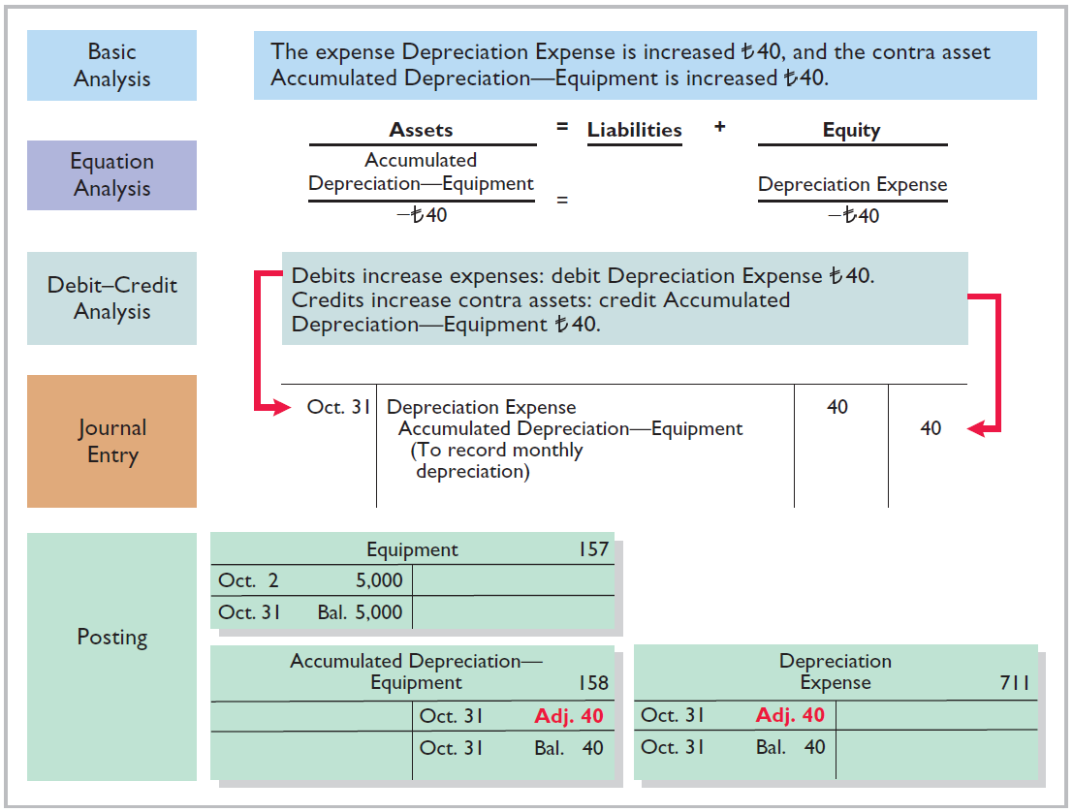
Illustration 3-7
Adjustment for depreciation
LO 5

Slide 29
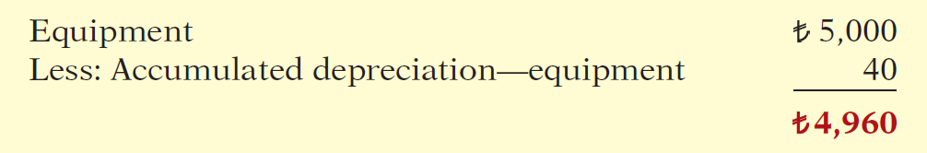
PREPAID EXPENSES
Statement Presentation
Accumulated Depreciation is a contra asset account (credit).
Appears just after the account it offsets (Equipment) on the balance sheet.
Book value is the difference between the cost of any depreciable asset and its accumulated depreciation.
Illustration 3-8
Statement of financial position presentation of accumulated depreciation
LO 5

Slide 30
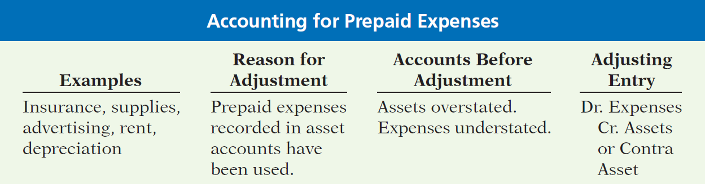
PREPAID EXPENSES
Illustration 3-9
Accounting for prepaid expenses
LO 5

Slide 31
UNEARNED REVENUES
Receipt of cash that is recorded as a liability because the service has not been performed.
Cash Receipt
BEFORE
Revenue Recorded
Unearned revenues often occur in regard to:
Rent
Airline tickets
Magazine subscriptions
Customer deposits
LO 5

Slide 32
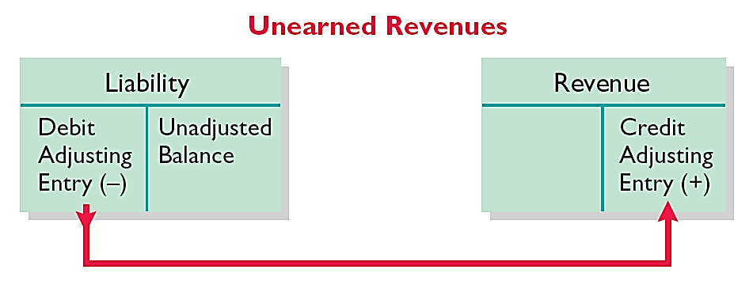
UNEARNED REVENUES
Adjusting entry is made to record the revenue for services performed during the period and to show the liability that remains at the end of the accounting period.
Results in a decrease (debit) to a liability account and an increase (credit) to a revenue account.
Illustration 3-10
Adjusting entries for unearned
revenues
LO 5

Slide 33
UNEARNED REVENUES
Illustration: Yazici Advertising Inc. received ₺1,200 on October 2 from R. Knox for advertising services expected to be completed by December 31. Unearned Service Revenue shows a balance of ₺1,200 in the October 31 trial balance. Analysis reveals that the company performed ₺400 of services in October.
Oct. 31
Unearned Service Revenue
400
Service Revenue
400
LO 5

Slide 34
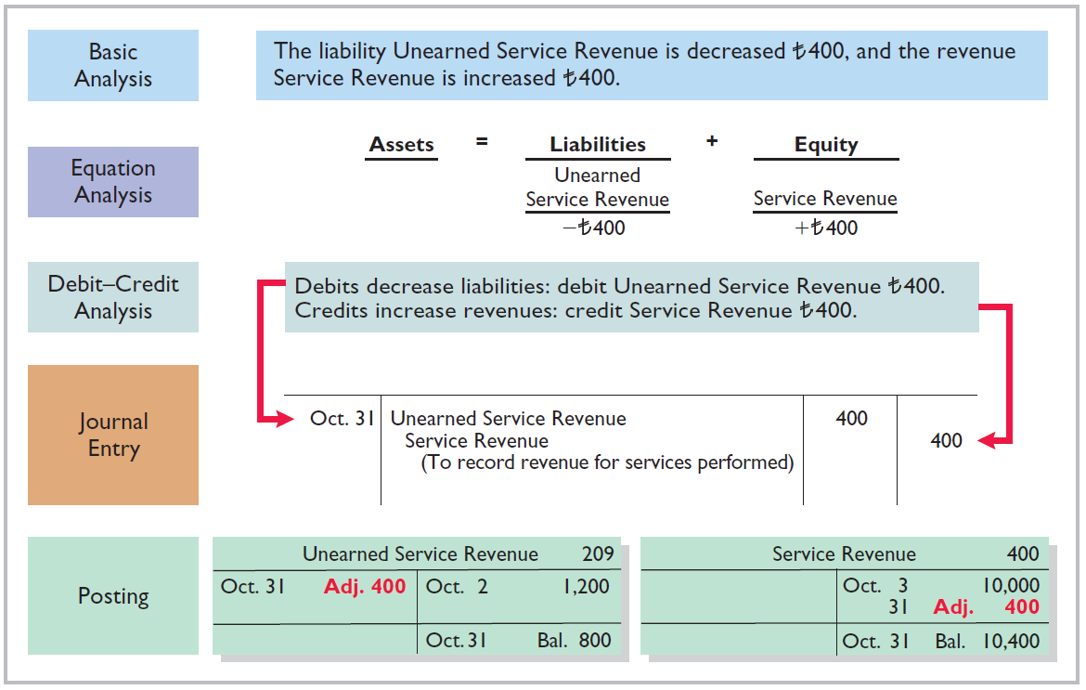
Illustration 3-11
Service revenue accounts after adjustment
LO 5

Slide 35
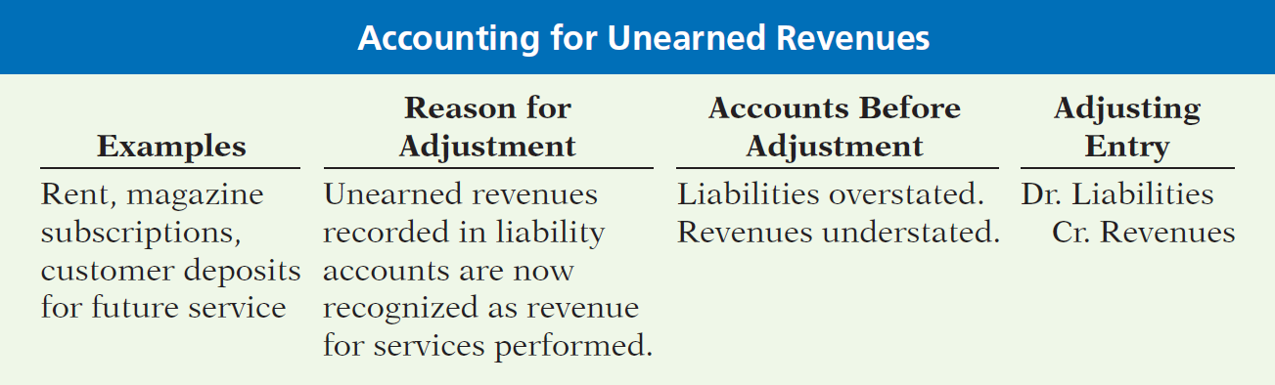
UNEARNED REVENUES
Illustration 3-12
Accounting for unearned revenues
LO 5

Slide 36
ACCOUNTING ACROSS THE ORGANIZATION
Turning Gift Cards into Revenue
Those of you who are marketing majors (and even most of you who are not) know that gift cards are among the hottest marketing tools in merchandising today. Customers at stores such as Marks & Spencer plc (GBR) purchase gift cards and give them to someone for later use. Although these programs are popular with marketing executives, they create accounting questions. Should revenue be recorded at the time the gift card is sold, or when it is exercised? How should expired gift cards be accounted for?
Source: Robert Berner, “Gift Cards: No Gift to Investors,” BusinessWeek (March 14, 2005), p. 86.
LO 5

Slide 37
>
DO IT!
The ledger of Zhu Company on March 31, 2017, includes these selected accounts before adjusting entries are prepared.
(amounts in thousands) Debit Credit
Prepaid Insurance ¥ 3,600
Supplies 2,800
Equipment 25,000
Accumulated Depreciation—Equipment ¥ 5,000
Unearned Service Revenue 9,200
An analysis of the accounts shows the following.
Insurance expires at the rate of ¥100 per month.
Supplies on hand total ¥800.
The equipment depreciates ¥200 a month.
One-half of the unearned service revenue was performed in March.
Prepare the adjusting entries for the month of March.
LO 5

Slide 38
>
DO IT!
The ledger of Zhu Company on March 31, 2017, includes these selected accounts before adjusting entries are prepared.
(amounts in thousands) Debit Credit
Prepaid Insurance ¥ 3,600
Supplies 2,800
Equipment 25,000
Accumulated Depreciation—Equipment ¥ 5,000
Unearned Service Revenue 9,200
Prepare the adjusting entries for the month of March.
Insurance expires at the rate of ¥100 per month.
Insurance Expense 100
Prepaid Insurance 100
LO 5

Slide 39
>
DO IT!
The ledger of Zhu Company on March 31, 2017, includes these selected accounts before adjusting entries are prepared.
(amounts in thousands) Debit Credit
Prepaid Insurance ¥ 3,600
Supplies 2,800
Equipment 25,000
Accumulated Depreciation—Equipment ¥ 5,000
Unearned Service Revenue 9,200
Prepare the adjusting entries for the month of March.
Supplies on hand total ¥800.
Supplies Expense 2,000
Supplies 2,000
LO 5

Slide 40
>
DO IT!
The ledger of Zhu Company on March 31, 2017, includes these selected accounts before adjusting entries are prepared.
(amounts in thousands) Debit Credit
Prepaid Insurance ¥ 3,600
Supplies 2,800
Equipment 25,000
Accumulated Depreciation—Equipment ¥ 5,000
Unearned Service Revenue 9,200
Prepare the adjusting entries for the month of March.
The equipment depreciates ¥200 a month.
Depreciation Expense 200
Accumulated Depreciation—Equipment 200
LO 5

Slide 41
>
DO IT!
The ledger of Zhu Company on March 31, 2017, includes these selected accounts before adjusting entries are prepared.
(amounts in thousands) Debit Credit
Prepaid Insurance ¥ 3,600
Supplies 2,800
Equipment 25,000
Accumulated Depreciation—Equipment ¥ 5,000
Unearned Service Revenue 9,200
Prepare the adjusting entries for the month of March.
One-half of the unearned service revenue was performed in March.
Unearned Service Revenue 4,600
Service Revenue 4,600
LO 5

Slide 42
Adjusting Entries for Accruals
Learning Objective 6 Prepare adjusting entries for accruals.
Accruals are made to record
Revenues for services performed but not
yet recorded at the statement date
(accrued revenues).
OR
Expenses incurred but not yet paid or recorded at the statement date (accrued expenses).
LO 6

Slide 43
ACCRUED REVENUES
Revenues for services performed but not yet received in cash or recorded.
Revenue Recorded
BEFORE
Cash Receipt
Accrued revenues often occur in regard to:
Rent
Interest
Services performed
LO 6

Slide 44
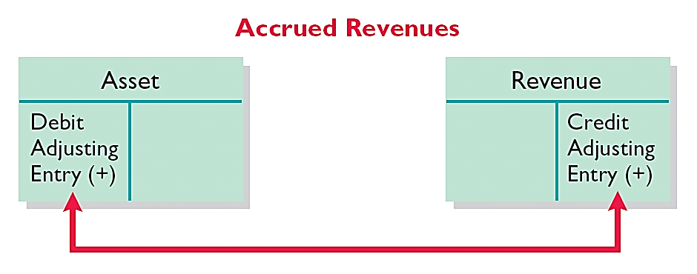
ACCRUED REVENUES
Adjusting entry records the receivable that exists and records the revenues for services performed.
Adjusting entry:
Increases (debits) an asset account and
Increases (credits) a revenue account.
Illustration 3-13
Adjusting entries for accrued
revenues
LO 6

Slide 45
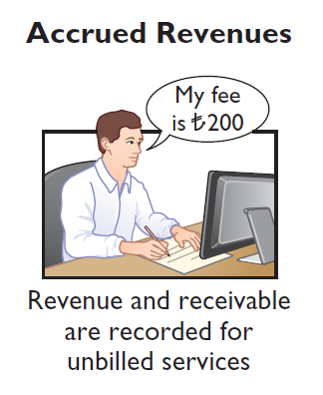
ACCRUED REVENUES
Illustration: In October, Yazici Advertising Inc. performed services worth ₺200 that were not billed to clients in October.
Oct. 31
Accounts Receivable
200
Service Revenue
200
On November 10, Yazici receives cash of ₺200 for the services performed.
Nov. 10
Cash
200
Accounts Receivable
200
LO 6

Slide 46
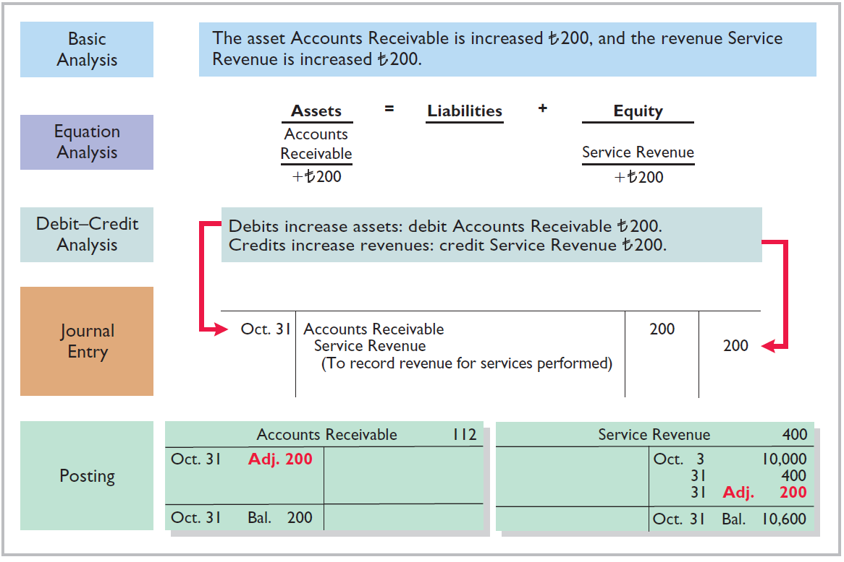
Illustration 3-14
Adjustment for accrued revenue
LO 6

Slide 47
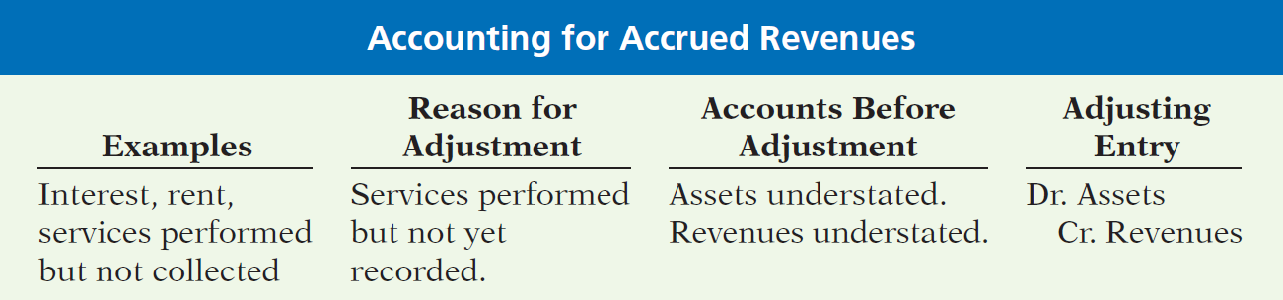
ACCRUED REVENUES
Illustration 3-15
Accounting for accrued revenues
LO 6

Slide 48
ACCRUED EXPENSES
Expenses incurred but not yet paid in cash or recorded.
Expense Recorded
BEFORE
Cash Payment
Accrued expenses often occur in regard to:
Interest
Taxes
Salaries
LO 6

Slide 49
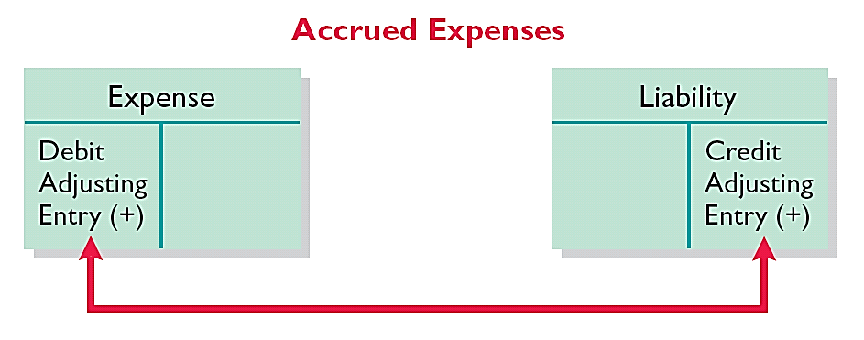
ACCRUED EXPENSES
Adjusting entry records the obligation and recognizes the expense.
Adjusting entry:
Increase (debit) an expense account and
Increase (credit) a liability account.
Illustration 3-16
Adjusting entries for accrued expenses
LO 6

Slide 50

ACCRUED INTEREST
Illustration: Yazici Advertising Inc. signed a three-month note payable in the amount of ₺5,000 on October 1. The note requires Yazici to pay interest at an annual rate of 12%.
Illustration 3-17
Formula for computing interest
Oct. 31
Interest Expense
50
Interest Payable
50
LO 6

Slide 51
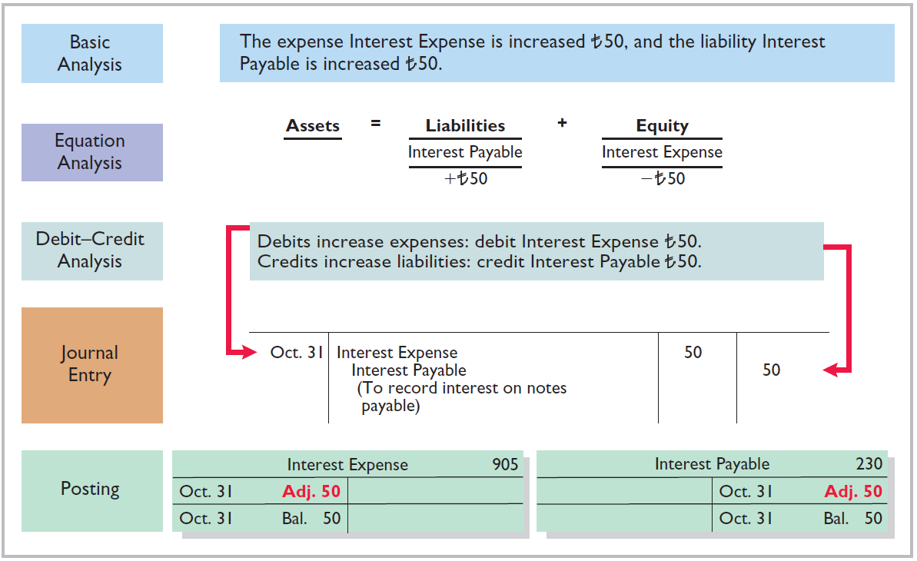
Illustration 3-18
Adjustment for accrued interest
LO 6

Slide 52
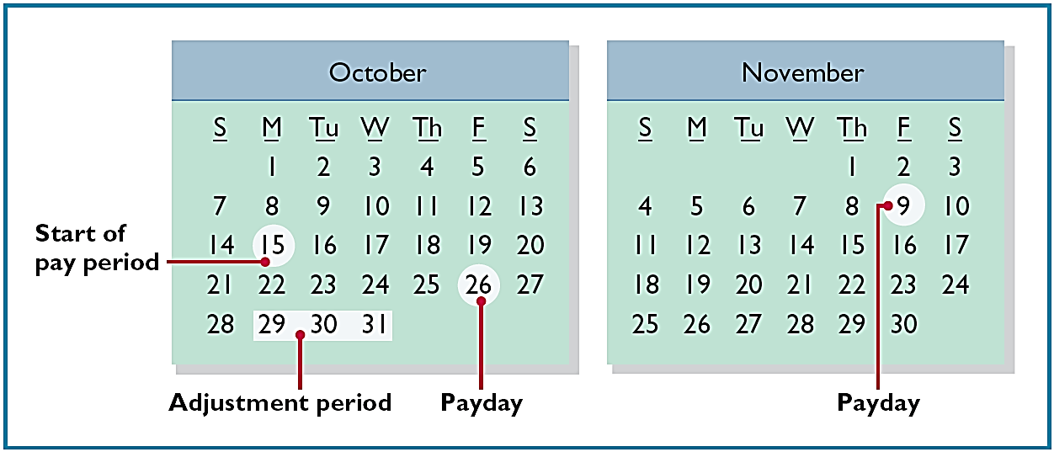
ACCRUED SALARIES AND WAGES
Illustration: Yazici paid salaries and wages on October 26; the next payment of salaries will not occur until November 9. The employees receive total salaries of ₺2,000 for a five-day work week, or ₺400 per day. Thus, accrued salaries at October 31 are ₺1,200 (₺400 x 3 days).
Illustration 3-19
Calendar showing Yazici’s pay
periods
LO 6

Slide 53
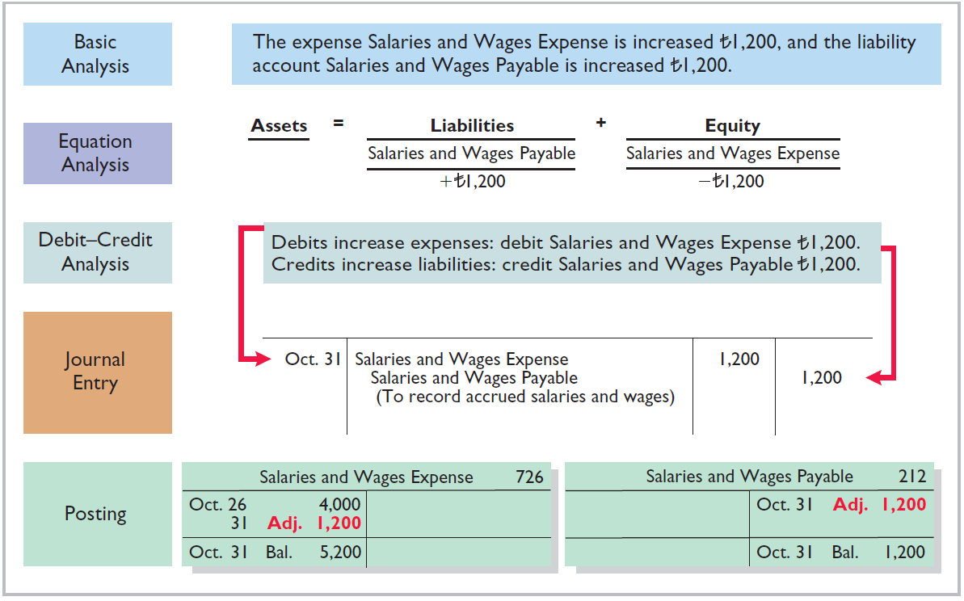
Illustration 3-20
Adjustment for accrued salaries and wages
LO 6

Slide 54
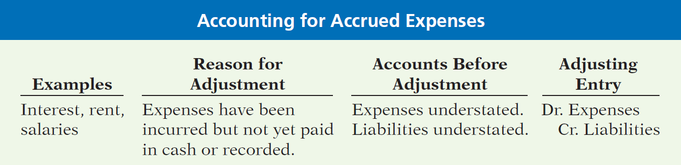
ACCRUED EXPENSES
Illustration 3-21
Accounting for accrued expenses
LO 6

Slide 55
People, Plant, and Profit Insight
Got Junk?
Do you have an old computer or two that you no longer use? How about an old TV that needs replacing? Many people do. Approximately 163,000 computers and televisions become obsolete each day. Yet, estimates indicate that only 11% of computers are recycled and 75% of all computers ever sold are sitting in storage somewhere, waiting to be disposed of. Each of these old TVs and computers is loaded with lead, cadmium, mercury, and other toxic chemicals. If you have one of these electronic gadgets, you have a responsibility, and a probable cost, for disposing of it. Companies have the same problem, but their discarded materials may include lead paint, asbestos, and other toxic chemicals.
LO 6

Slide 56
>
DO IT!
Micro Computer Services began operations on August 1, 2017. At the end of August 2017, management prepares monthly financial statements. The following information relates to August.
At August 31, the company owed its employees ¥8,000 in salaries and wages that will be paid on September 1.
On August 1, the company borrowed ¥300,000 from a local bank on a 15-year mortgage. The annual interest rate is 10%.
Revenue for services performed but unrecorded for August totaled ¥11,000.
Prepare the adjusting entries needed at August 31, 2017.
LO 6

Slide 57
>
DO IT!
Prepare the adjusting entries needed at August 31, 2017.
At August 31, the company owed its employees ¥8,000 in salaries and wages that will be paid on September 1.
On August 1, the company borrowed ¥300,000 from a local bank on a 15-year mortgage. The annual interest rate is 10%.
Revenue for services performed but unrecorded for August totaled ¥11,000.
Salaries and Wages Expense 8,000
Salaries and Wages Payable 8,000
Interest Expense 2,500
Interest Payable 2,500
Accounts Receivable 11,000
Service Revenue 11,000
LO 6

Slide 58
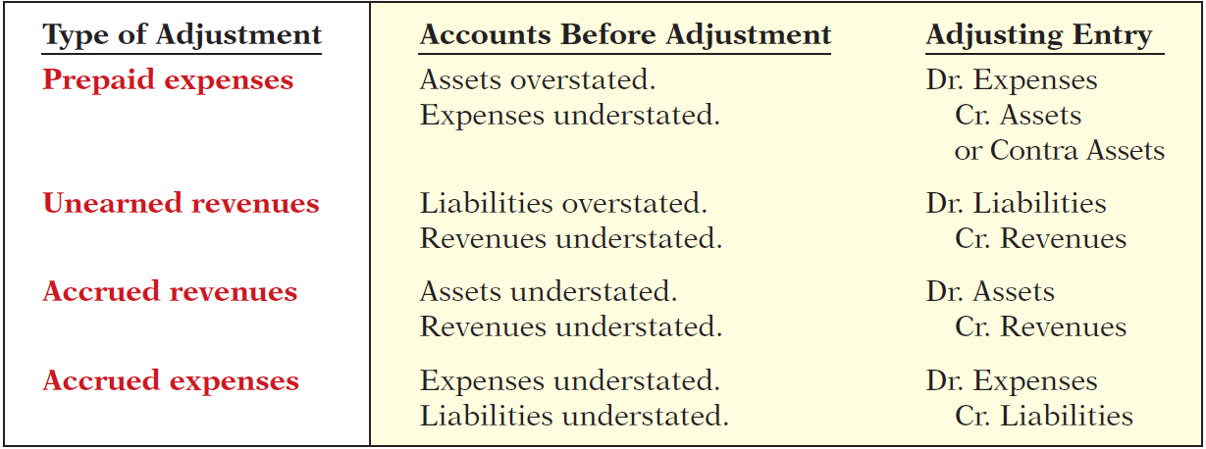
Summary of Basic Relationships
Illustration 3-22
Summary of adjusting entries
LO 6

Slide 59
The Adjusted Trial Balance and Financial Statements
Learning Objective 7
Describe the nature and purpose of an
adjusted trial balance.
Preparing the Adjusted Trial Balance
Prepared after all adjusting entries are
journalized and posted.
Purpose is to prove the equality of debit balances and credit balances in the ledger.
Is the primary basis for the preparation of financial statements.
LO 7

Slide 60
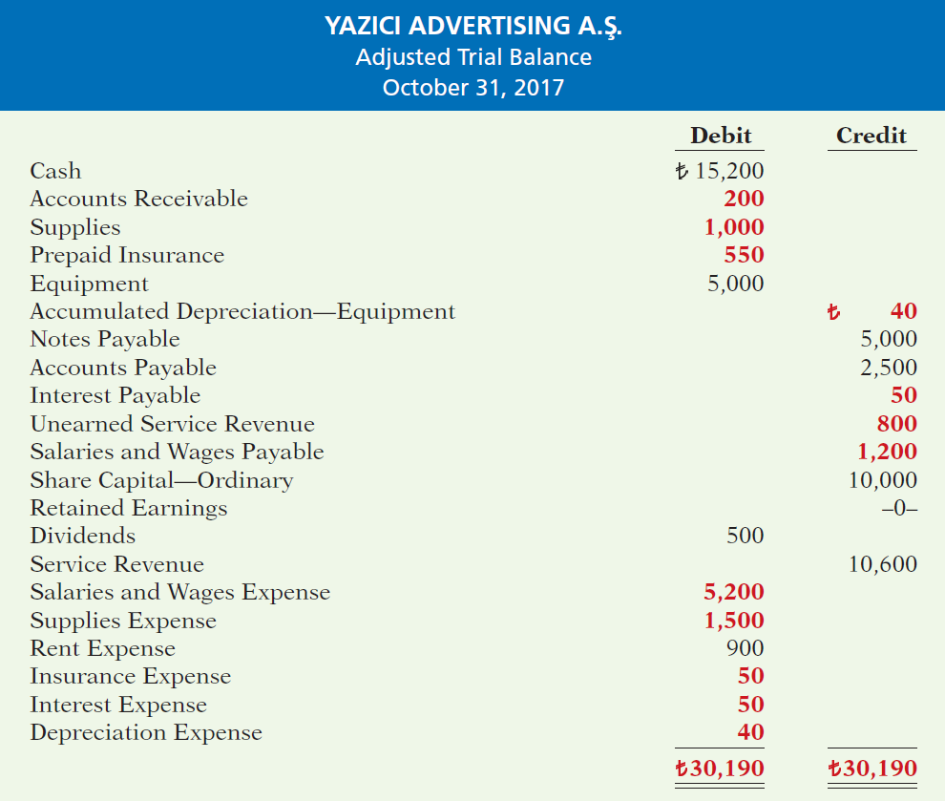
Illustration 3-25
Adjusted trial balance
LO 7

Slide 61
Preparing the Adjusted Trail Balance
Question
Which of the following statements is incorrect concerning the adjusted trial balance?
(a) An adjusted trial balance proves the equality of the total debit balances and the total credit balances in the ledger after all adjustments are made.
The adjusted trial balance provides the primary basis for the preparation of financial statements.
The adjusted trial balance lists the account balances segregated by assets and liabilities.
The adjusted trial balance is prepared after the adjusting entries have been journalized and posted.
LO 7

Slide 62
Preparing Financial Statements
Financial Statements are prepared directly from the Adjusted Trial Balance.
Income Statement
Retained Earnings Statement
Statement of Financial Position
LO 7

Slide 63
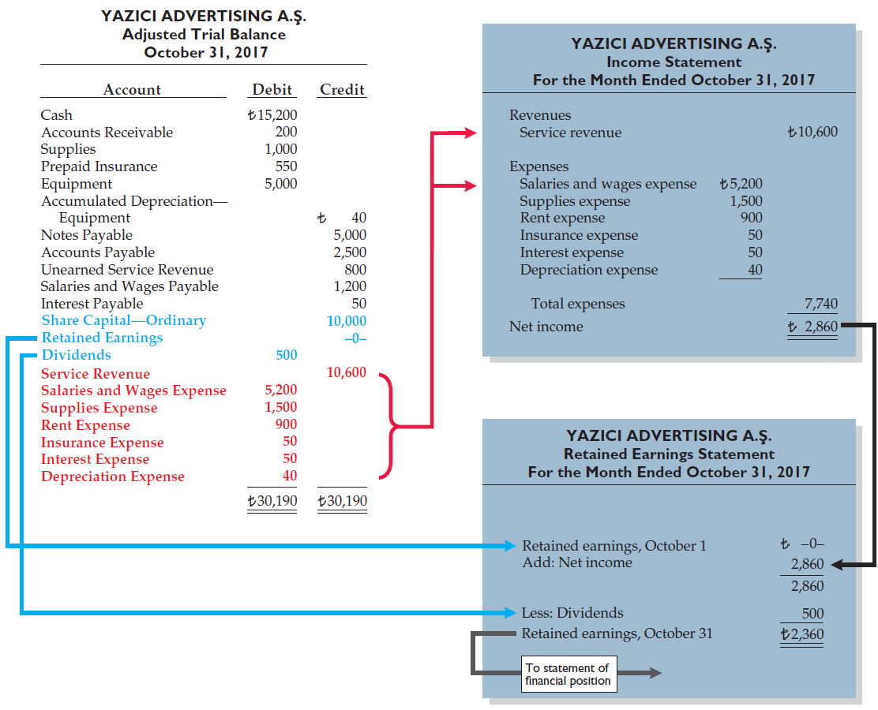
Illustration 3-26
Preparation of the income statement and retained earnings statement from the adjusted trial balance
LO 7

Slide 64
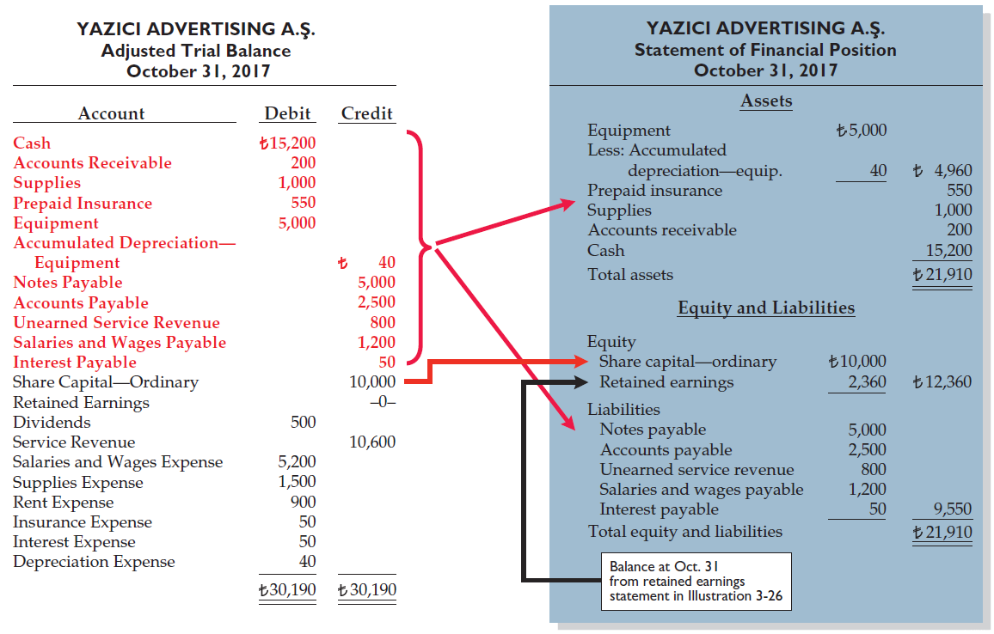
Illustration 3-27
Preparation of the statement of financial position from the adjusted trial balance
LO 7

Slide 65
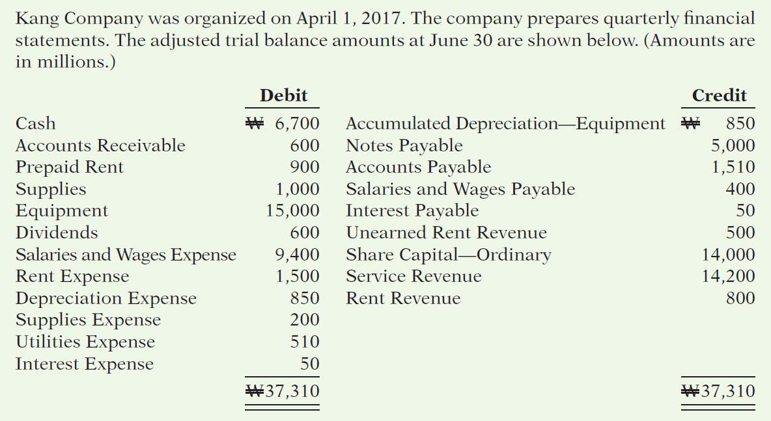
>
DO IT!
LO 7

Slide 66
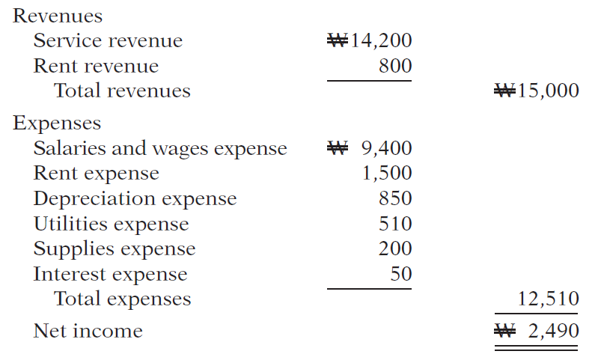
>
DO IT!
(a) Determine the net income for the quarter April 1 to June 30.
LO 7

Slide 67
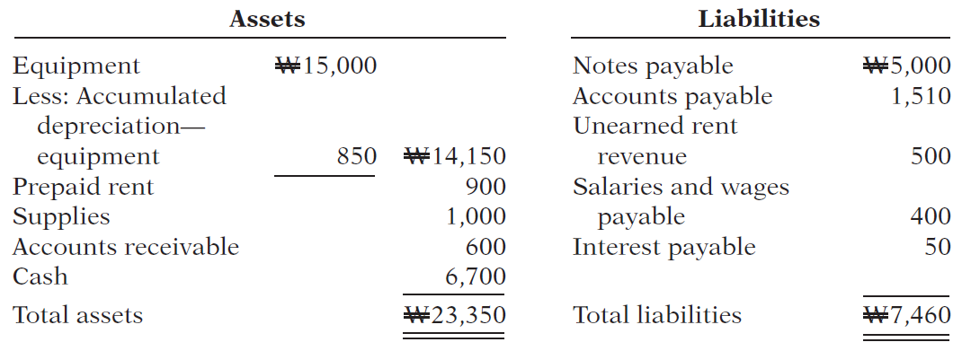
>
DO IT!
Determine the total assets and total liabilities at June 30, 2017, for Skolnick Co.
LO 7

Slide 68
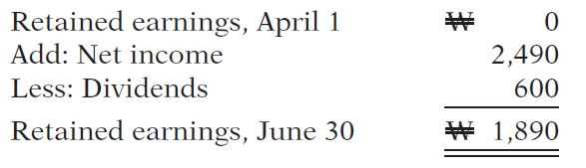
>
DO IT!
Determine the amount that appears for retained earnings at June 30, 2017.
LO 7

Slide 69
APPENDIX 3A
Alternative Treatment of Prepaid Expenses and Unearned Revenues
Learning Objective 8
Prepare adjusting entries for the alternative
treatment of deferrals.
Alternate Treatment
When a company prepays an expense, it debits that amount to an expense account.
When it receives payment for future services, it credits the amount to a revenue account.
LO 8

Slide 70
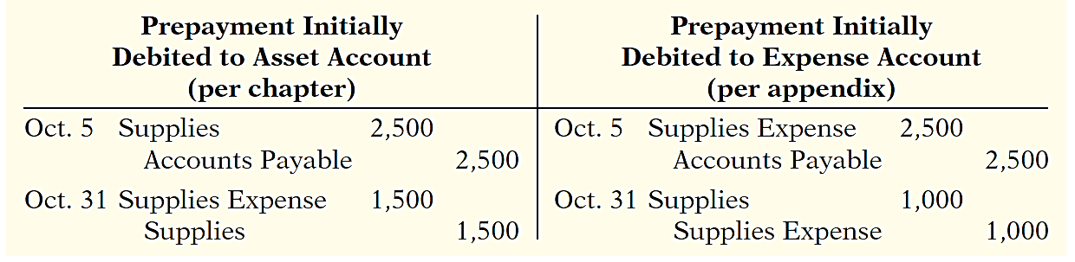
Prepaid Expenses
Company may choose to debit (increase) an expense account rather than an asset account. This alternative treatment is simply more convenient.
Illustration 3A-2
Adjustment approaches—a comparison
LO 8

Slide 71
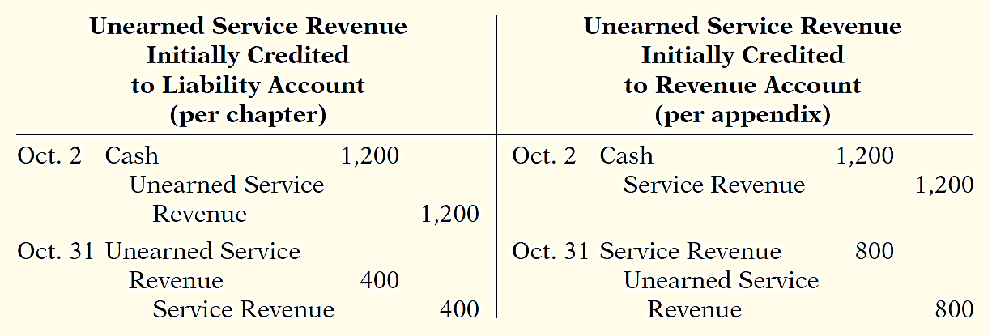
Unearned Revenues
Company may credit (increase) a revenue account when they receive cash for future services.
Illustration 3A-5
Adjustment approaches—a comparison
LO 8

Slide 72
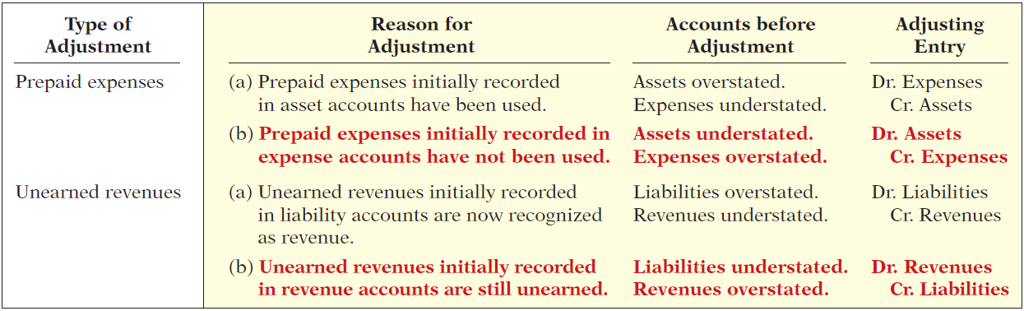
Summary of Additional Adjustments Relationships
Illustration 3A-7
Summary of basic relationships for deferrals
LO 8

Slide 73
APPENDIX 3B
Concepts in Action
Learning Objective 9
Discuss financial reporting concepts.
Qualities of Useful Information
Two fundamental qualities, relevance and
faithful representation.
Relevance
Make a difference in a business decision.
Provides information that has predictive value and confirmatory value.
Materiality is a company-specific aspect of relevance.
An item is material when its size makes it likely to influence the decision of an investor or creditor.
LO 9

Slide 74
Qualities of Useful Information
Two fundamental qualities, relevance and faithful representation.
Faithful Representation
Information accurately depicts what really happened.
Information must be
complete (nothing important has been omitted),
neutral (is not biased toward one position or another), and
free from error.
LO 9

Slide 75
Qualities of Useful Information
ENHANCING QUALITIES
Comparability results when different companies use the same accounting principles.
Information is verifiable if independent
observers, using the same methods, obtain similar results.
Information has the quality of understandability
if it is presented in a clear and concise fashion.
Consistency means that a company uses the same accounting
principles and methods from year to year.
For accounting information to have relevance, it must be timely.
LO 9

Slide 76
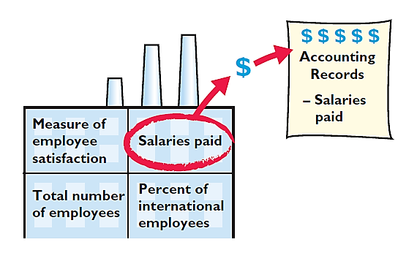
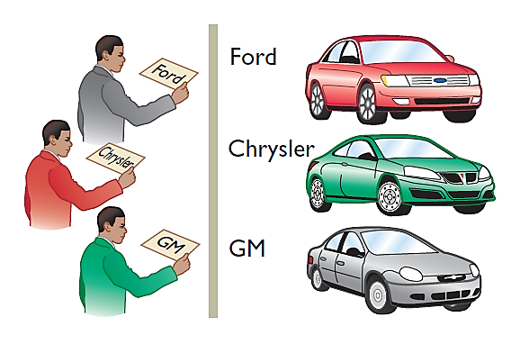
Assumptions in Financial Reporting
Monetary Unit
Economic Entity
Requires that only those things that can be expressed in money are included in the accounting records.
States that every economic entity can be separately identified and accounted for.
Illustration 3B-2
Key assumptions in financial reporting
LO 9

Slide 77
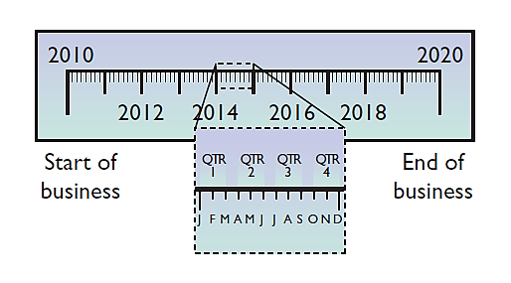

Assumptions in Financial Reporting
Time Period
Going Concern
States that the life of a business can be divided into artificial time periods.
The business will remain in operation for the foreseeable future.
Illustration 3B-2
Key assumptions in financial reporting
LO 9

Slide 78
Principles of Financial Reporting
MEASUREMENT PRINCIPLES
Historical Cost
Fair Value
Or cost principle, dictates that companies record assets at their cost.
Indicates that assets and liabilities should be reported at fair value (the price received to sell an asset or settle
a liability).
LO 9

Slide 79
Principles of Financial Reporting
REVENUE RECOGNITION PRINCIPLE
EXPENSE RECOGNITION PRINCIPLE
FULL DISCLOSURE PRINCIPLE
Requires that companies recognize revenue in the accounting period in which the performance obligation is satisfied.
Dictates that efforts (expenses) be matched with results (revenues). Thus, expenses follow revenues.
Requires that companies disclose all circumstances
and events that would make a difference to financial statement users.
LO 9

Slide 80
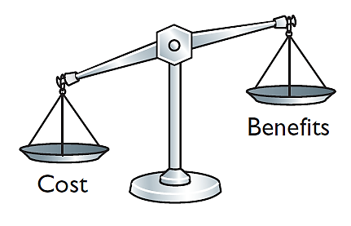
Cost Constraint
Cost Constraint
Accounting standard-setters weigh the cost that companies will incur to provide the information against the benefit that financial statement users will gain from having the information available.
LO 9

Slide 81
A Look at U.S. GAAP
Learning Objective 10
Compare the procedures for the adjusting entries under IFRS and U.S. GAAP.
Key Points
Similarities
Like IFRS, companies applying GAAP use
accrual-basis accounting to ensure that they record transactions that change a company’s financial statements in the period in which events occur.
Similar to IFRS, cash-basis accounting is not in accordance with GAAP.
GAAP also divides the economic life of companies into artificial time periods. Under both GAAP and IFRS, this is referred to as the time period assumption. GAAP requires that companies present a complete set of financial statements, including comparative information annually.
The form and content of financial statements are very similar under GAAP and IFRS. Any significant differences will be discussed in those chapters that address specific financial statements.
Revenue recognition fraud is a major issue in U.S. financial reporting. The same situation exists for most other countries as well.
LO 10

Slide 82
A Look at U.S. GAAP
Key Points
Differences
Prior to the issuance of a new joint revenue recognition standard by the IASB and the FASB, GAAP had more than 100 rules dealing with revenue recognition. Many of these rules were industry-specific. Revenue recognition under IFRS was determined primarily by a single standard, IAS 18. Despite this large disparity in the detailed guidance devoted to revenue recognition, the general revenue recognition principles required by IFRS were similar to those under GAAP.
Internal controls are a system of checks and balances designed to detect and prevent fraud and errors. The Sarbanes-Oxley Act requires U.S. companies to enhance their systems of internal control. However, many foreign companies do not have this requirement.
LO 10

Slide 83
A Look at U.S. GAAP
Key Points
Differences
Under IFRS, revaluation to fair value of items such as land and buildings is permitted. This is not permitted under GAAP.
Under IFRS, the term “income” includes both revenues, which arise during the normal course of operating activities, and gains, which arise from activities outside of the normal sales of goods and services. The term income is not used this way under GAAP. Instead, under GAAP income refers to the net difference between revenues and expenses. Expenses under IFRS include both those costs incurred in the normal course of operations, as well as losses that are not part of normal operations. This is in contrast to GAAP, which defines each separately.
LO 10

Slide 84
A Look at U.S. GAAP
Looking to the Future
In May 2014, the IASB and FASB completed a joint project on revenue recognition. The purpose of this project was to develop comprehensive guidance on when to recognize revenue. This approach focuses on changes in assets and liabilities as the basis for revenue recognition. It is hoped that this approach will lead to more consistent accounting in this area.
LO 10

Slide 85
A Look at U.S. GAAP
A Look at IFRS
IFRS Self-Test Questions
GAAP:
provides the same type of guidance as IFRS for revenue recognition.
provides only general guidance on revenue recognition, compared to the detailed guidance provided by IFRS.
allows revenue to be recognized when a customer makes an order.
requires that revenue not be recognized until cash is received.
LO 10

Slide 86
A Look at U.S. GAAP
A Look at IFRS
IFRS Self-Test Questions
Which of the following statements is false?
GAAP employs the time period assumption.
GAAP employs accrual accounting.
GAAP requires that revenues and costs must be capable of being measured reliably.
GAAP uses the cash basis of accounting.
LO 10

Slide 87
A Look at U.S. GAAP
A Look at IFRS
IFRS Self-Test Questions
Which of the following statements is false?
Under IFRS, the term income describes both revenues and gains.
Under IFRS, the term expenses includes losses.
Under IFRS, firms do not engage in the closing process.
IFRS has fewer standards than GAAP that address revenue recognition.
LO 10

Slide 88
Copyright
“Copyright © 2016 John Wiley & Sons, Inc. All rights reserved. Reproduction or translation of this work beyond that permitted in Section 117 of the 1976 United States Copyright Act without the express written permission of the copyright owner is unlawful. Request for further information should be addressed to the Permissions Department, John Wiley & Sons, Inc. The purchaser may make back-up copies for his/her own use only and not for distribution or resale. The Publisher assumes no responsibility for errors, omissions, or damages, caused by the use of these programs or from the use of the information contained herein.”

